Slide 1
Acknowledgement Internet Images, available in Public Domain, have been used in many Slides of this Presentation. Some of the Images have also been Modified/Superimposed. Used only for Academic Purpose/Understanding.

Slide 2
Concepts in Building First Principle Math-Stat Models
Dynamics of Structures, Mech. & Process Sys., Power Sys.; Inst., Eqpt. & Final Control Elements
Mechanical (typical):
Structures --- FEM Models/Stress-Strain Models of Mech. Structures
Piping --- N/W Models, Thermal Expansion & Pipe Support Models
Roto-Dynamic Eqpt --- Simplified I/P-O/P ODE/PDE Models, Eigen-structures of Shafts Hydro-Dynamic & Hydro-Static Bearing Models,
Process Eqpt. etc. --- Heat & Mass Transfer Models
Control Eqpt. --- Transfer Fn. Models, Frequency Domain Models
Electrical (typical) :
Power Supplies/VFDs/ Power Devices, etc. --- Transfer Fn., State-space, Freq. Domain Models
Motors/Drives/Servo Devices, etc. --- D-Q Axes Framework/State-Space
Instrumentation (typical) :
Process Sensors & Inst. Systems ---- Transfer Function & Freq. Domain Models
Chemical-Electro-Chemical Sensors ---- State Space Models (derived from electro- chemistry phenomena)
Domain-specific Inst. ---- First-principle, Phenomenological, Data-based
Computer based Systems (typical) :
Embedded Real-time Sys. & OS, ---- Boolean Models, Finite-State Machines,
Historians, Alarm- Annunciations, etc. ---- Data-Flow Structures, Automatons, Petri-Nets

Slide 3
Safety Concepts in Critical Infra Projects
Plant-Wide Monitoring Envelope
Failure Postulations, Hazard Analysis, Risk Studies Envelope
Safety Related Envelope
Computer Infrastructure & Data Acquisition
Safety Envelope
Apriori Computation of System-Characteristics. (Transient & Steady-State) & Safety Limits
Domain Knowledge, Simulations, Experiments on Prototypes

Slide 4
Safety System Design
Fault Tolerant Design
Intrinsically Safe Design
Safety Systems
Rugged Design
Fail Safe
Design
Smart Sensing, Actuation & Controls
Redundancy
Single Failure Criteria
Multiple Failure Criteria/ Beyond Design Basis
Physical
Diversity
Analytical
Towards Intrinsic Safety
Diagnostics/Predictive Maintenance

Slide 5
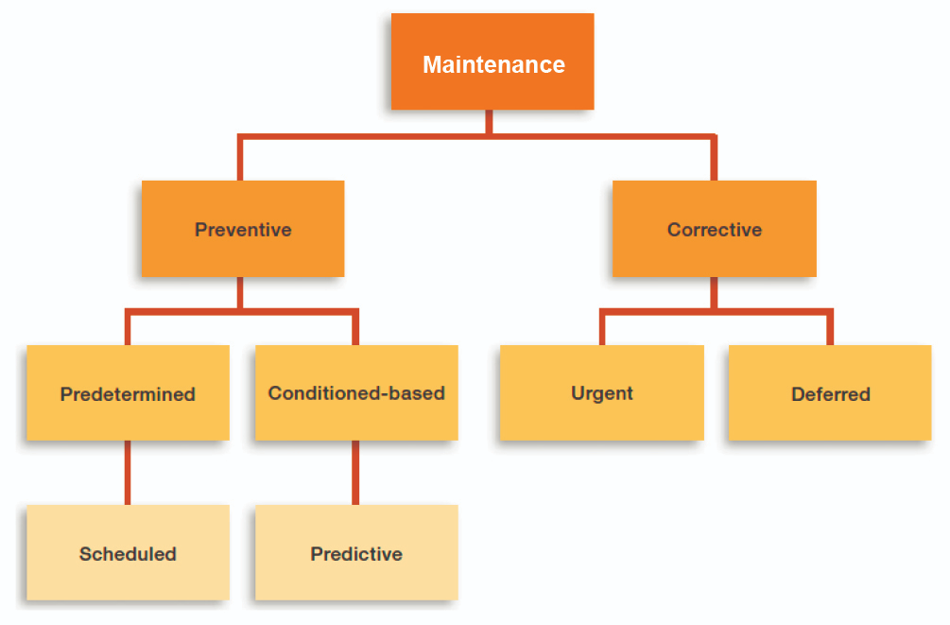
The Present-day Paradigms of Total Maintenance Management
Fault Detection & Diagnostics
Individual Knowledge
Maint. Logs of Sys./Eqpt.
Experience Feedback
Trade-based Skill-sets
Procedures (OEM Guidelines)
Data Base/Data-Structure/ Big-Data Analytics
Algorithms, Math-Stat Models
Condition based Maint.
In-service Inspection
Data Analysis of On-Line Measurements
Reliability Models
Redundant Sys. in Opn.
Hot /Cold Standby
Arrhenious/Eyrring Models
OEM Guidelines, Skill-sets, Graceful Degradation
Hybrid Models (Mechansitic & Data-Oriented)
Transient & Steady State Data
Filtering, Estimation, De-Noising
Fault Detection/Diagnostics Algorithms
Inferential Statistics
Boolean & Discrete Event System Models
Prognostics & Forecasting
Reliability, Availability, Maintainability, Inspectability

Slide 6
Systems & Plant Operating Boundaries
Assessment of the Safety Envelope/Boundaries
Formulation of Postulated Initiating Events (PIE)
Dynamics of PIEs
Fundamental Analysis, CFD, FEM, etc.
Choice of Sensor & Inst. Systems
Adequacy of Sensor Type & Position/Mounting
Sensor Accuracy & Time Constants
Signal Conditioning Error & Processing Time
Safety Assessment of Network Protocols /WSN
Data Processing, Data Mining, Big Data Analytics
Plant-wide EMI Assessment & Inst. Design for EMC
Human Machine Interface Perspective
HMI
Normal Operations Boundary
Safety Boundary
Safety Related Boundary
Data Processing

Slide 7
Indicative Safety Paradigms for a Process
Amplitude
Safety Limits (SL)
Limiting Safety
Settings (LSS)
Limiting Conditions
for Operation (LCO)
Plant Transients
SL
LSS
LCO
Normalized Real-Time
Response Time for Mitigating Action

Slide 8
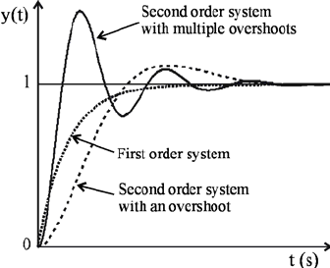
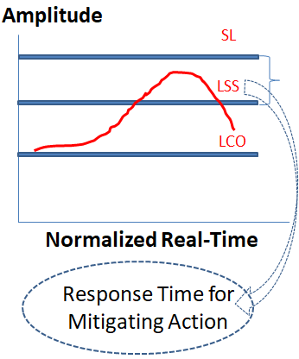
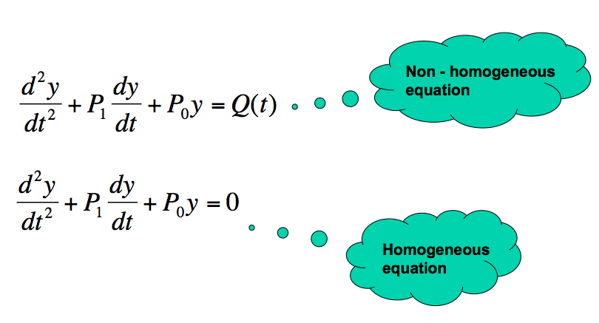
Sensors, Actuators & System Characteristics & Plant Safety
Response Characteristics
Order of Sensor/Process
Uncertainty
H.O. ODE/PDE
Integrating Sensor, Process & Actuator

Slide 9
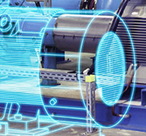
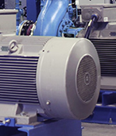
Creating Digital Twins --- A Model Based Approach
3D Modeling/ 3D Graphics Software
Simulation Code FEM Models/ Dynamic Models, etc.
Virtual Reality Software
IOT/WSN
Creating Digital Twin

Slide 10
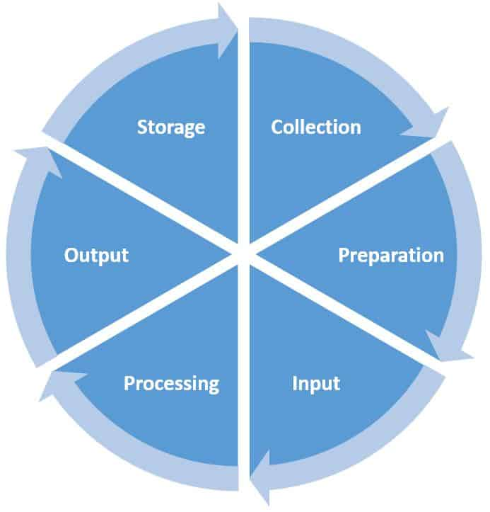
Building Digital Twins from Data Mining Paradigms
Wear-housing
Clustering, Classification
Digital Twin
Use the Mined Data from Physical Assets to Build Digital Assets
De-noising, Rule Mining
Hybrid Models
Missing Data Analysis
Principal Component Analysis

Slide 11
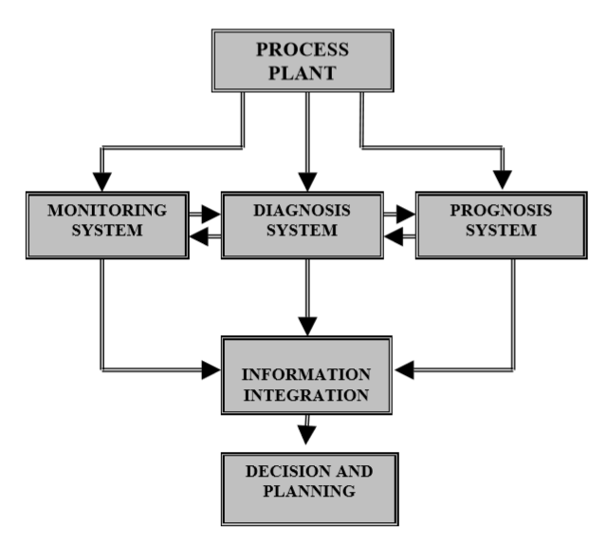
Smart Controls, Diagnostics, Prediction/Prognosis
Math-Stat Models
WSN/IOT Devices
Controls
Estimators / Virtual Sensors
Simulators
Prognostics
Statistical Models
Digital Twins
Inferential Statistics/ Hypothesis Testing
Real-time Performance Evaluation
Uncertainties
Bayesian Approach
Use of Digital Twins

